Slide 1
Statement on Standards
for Forensic Services
(SSFS No. 1)
Presented by:
Harry Sturgis, CPA/ABV, ASA
Nicole Dell

Slide 2
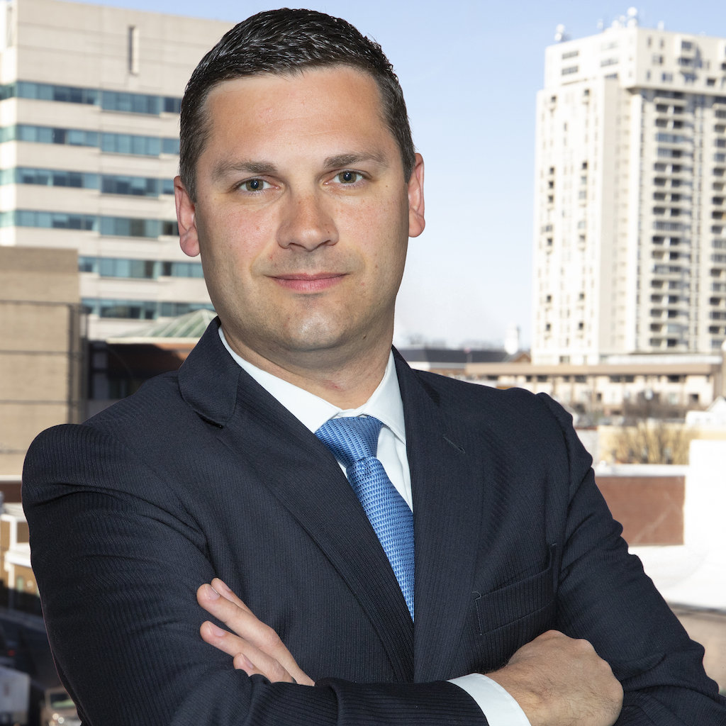
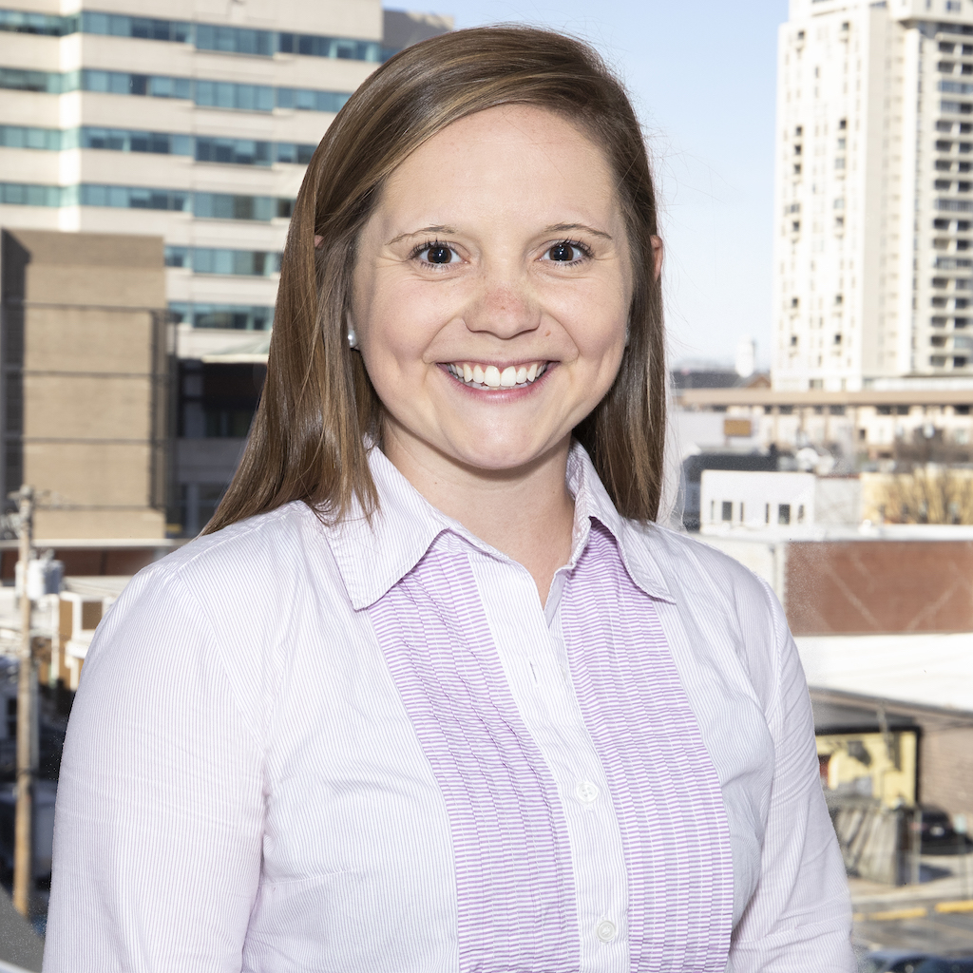
Introductions
Harry Sturgis
Manager
Experience: 7 years
CPA, ABV, ASA
Employed with Vallit Advisors since April 2019
Nicole Dell
Forensic Accounting Analyst
Experience: 3 ½ years
Employed with Vallit Advisors since April 2019
Notes:
Nicole
Welcome, we appreciate the opportunity we have to present in front of all of you!
Please feel free to ask any questions during the presentation.
We certainly would like audience participation and input.
If time allows, we have built in multiple case examples to discuss how we think the standards will play a role, and again would appreciate any audience participation if you have examples or war stories to add.

Slide 3
What Are The Standards?
SSFS No. 1 establishes standards for members and member firms who are providing services as part of litigation and investigation engagements
Vallit Advisors, LLC
3
Notes:
Nicole
So, what exactly are the standards?
By definition and according to the AICPA SSFS No.1………

Slide 4
Responsibility for Creation of SSFS No.1
These standards were issued by the American Institute of Certified Public Accountants (AICPA) Forensic and Valuation Services Executive Committee (FVSEC)
FVSEC provides guidance and establishes enforceable standards for members performing certain forensic and valuation services.
The FVSEC has been designated by the AICPA as a body to establish professional standards under the “Compliance with Standards Rule” of the AICPA’s Code of Professional Conduct
Notes:
Nicole
The AICPA has a Forensic and Valuation Services Executive Committee, abbreviated to be (FVSEC). The committee consists of approximately 10 members of which are from all over the country. Now there is one member who is from the DC area, so is there a Jason Flemings in the audience? (Oh great, you can come up and help present) (Darn, we were really looking forward for some of his input)
The FVSEC provides guidance and establishes enforceable standards for members performing certain forensic and valuation services.
The AICPA designated this committed as a body to establish professional standards under the Compliance with Standards Rule of the AICPA’s Code of Professional Conduct

Slide 5
History and Development
The exposure draft of the standards was released in December 2018.
The committee had been developing the standards for almost three years.
The original effective date was May 1, 2019 however, that has been changed.
A final draft of the standards is expected June 1, 2019.
The official date for adoption is now January 1, 2020.
Early adoption is permitted.
Notes:
Nicole
As we all are most likely aware, these standards were released as an exposure draft in December of 2018. Since they have been released, there has been tons of professional input and questions regarding the standards. The original release date was supposed to be May 1, 2019 however, that was postponed until June 1, 2019. The committee had been developing these standards for about 3 years now and we actually had a chance to speak with an individual from the AICPA and her name was Barbara. She was telling us since there was so much feedback from the exposure draft, they felt it was better to delay the release of the official standards to best capture the concerns of the public. All of the comments were taken into consideration for the update. The official date for adoption is now January 1, 2020.

Slide 6
Why Were They Issued?
Protect the public interest by improving the consistency and quality of practice among AICPA members performing Forensic Services.
Provide more authoritative guidance to members and member firms that perform a variety of forensic services.
The demand for Forensic Accounting services has continued to increase.
Per the IBISWorld report, employment in forensic accounting grew at an annualized rate of 18% from 2012 to 2017.
Vallit Advisors, LLC
6
Notes:
Nicole
I’m sure we all want to know the main reason for these standards. The main reason is to protect the public interest by improving the consistency and quality of practice among AICPA members performing Forensic Services.
It was interesting to find out that the demand for forensic accounting services has continue to increase over the past 5 years. Per the IBIS……..
They are also focusing on providing more authoritative guidance to members and member firms that perform a variety of forensic services.

Slide 7
Key Terms:
As Defined by Merriam-Webster:
Forensic – belonging to, used in, or suitable to courts of judicature or to public discussion and debate
As Defined by the AICPA:
Forensic – “used in, or suitable to, courts of law or public debate”
Forensic Accounting Services – involves the application of specialized knowledge and investigative skills to collect, analyze and evaluate certain evidential matter and to interpret and communicate findings.
Vallit Advisors, LLC
7
Notes:
Nicole
To understand some of the standards, we’ve provided some technical yet very fundamental definitions.
(Define Forensic based on Webster and AICPA) (Define Forensic Accounting Services)
Harry to ask, “did everyone understand?”
Forensic covers anything that is used in, or suitable to courts of law or public debate.
This would mean that business valuations, litigation related cases and others that are brought forth in court are to be considered forensic accounting services

Slide 8
Key Terms:
Two-Pronged Approach to determining applicability:
Litigation – “an actual or potential legal or regulatory proceeding before a trier of fact or a regulatory body as an expert, consultant, neutral, mediatory or arbitrator in connection with the resolution of disputes between parties. Litigation used herein is not limited to formal litigation, but is inclusive of other alternative dispute resolution forums”
Investigation – “a matter that is not a litigation but which may involve using the same skills and the services are performed in response to specific concerns of wrong doing in which the member is engaged to perform procedures to collect, analyze, evaluate or interpret certain evidential matter to assist the stakeholder (client) in reaching a conclusion on the merits of their concerns”
Vallit Advisors, LLC
8
Notes:
Nicole
In order to determine if the standards apply to you or the work you are performing, it is important o grasp the two-pronged approach to applicability
First part is Litigation….. (read definition)
Second is Investigation …… (read definition)

Slide 9
Two-Pronged Examples:
A non-profit company was being audited by a second year CPA firm, however there was concern of mishandling of funds so a forensic accounting firm was hired.
Analysis showed a member of the accounting department at the non-profit company stole $572,000.
Turned over to the State prosecutor and ultimately convicted
Litigation or Investigation?
The PTA of an elementary school was concerned their acting president was stealing money from the PTA funds. Forensic firm was hired to analyze any trends in the spending.
Analysis showed more than $15,000 was stolen from the PTA, as the president often used the debit card for personal purchases
Findings were taken and presented to PTA’s attorney and board.
Litigation or Investigation?
Vallit Advisors, LLC
9
Notes:
Nicole
To dive into each of these approaches to applicability, we have provided two examples. Once we go into the details of the examples, we would appreciate your participation in whether or not you think they constitute as either an investigation or litigation engagement.
The first example: (read case facts and ask audience for litigation or investigation)
The second example: (read case facts and ask audient for litigation or investigation)

Slide 10
Application
Focused on the purpose of the services rather than the nature of the services or skill set employed.
Does the engagement scope include services for purposes of litigation or an investigation, or constitute a need for such services?
If yes:
These standards would apply.
For services previously engaged, but were modified or amended to include litigation and/or investigation, a modification of the understanding of the engagement should be established with the client.
If no:
These standards would not apply.
Vallit Advisors, LLC
10
Notes:
Nicole
These standards tend to focus more on the purpose of the engagement rather than the services or skill set needed.
So, the main question you want to ask yourself is whether or not the engagement scope includes services for the purpose of litigation or investigation.
If yes…..
Now, for engagements previously engaged, it is important to note that if the scope was modified or amended to include litigation or investigation, a modification of the understanding of the engagement should be established with the client. We will touch on this later in the presentation, but it’s important to note any changes should be clearly relayed to the client.
If no……these standards would simply not apply

Slide 11
What Services Would be Included?
Forensic Services including, but not limited to:
Financial Fraud
Breach of Contract
Hidden Assets
Economic Damages
Business Valuation
These services could also be covered under the VS Section 100 (SSVS No. 1)
SSFS No. 1 standards can also apply to services provided under VS Section 100 as part of a litigation or investigation engagement.
There may be some overlap on the type of service and the standards which apply.
Vallit Advisors, LLC
11
Notes:
Harry
So now we are going to cover some of the forensic services that could be subject to the new statement on standards for forensic services from the AICPA. We’ve put together a list, which is not all inclusive, of the services we identified such as Financial Fraud, Breach of Contract, Hidden Assets, Economic Damages and Business Valuation. I’m sure many of you in here are familiar with the statement on standards for valuation services, commonly called SSVS or VS section 100. It is helpful to note that in the event you are working on a business valuation in the context of a litigation or investigation engagement, your business valuation services are subject to SSVS as well as the new forensic accounting standards. Both sets of standards would apply, not one or the other.

Slide 12
What Services Would Not be Included?
“This statement of standards does not apply to audit, review, compilation, attestation or tax engagements”
There is one exception to attestation:
Agreed Upon Procedures (AUP)
Cannot report findings under AUP standards if engaged by one party in litigation to provide expert opinions
AUP standards do not allow for providing an opinion or negative assurance
Can report findings under AUP standards if engaged by the trier of fact and/or both sides of the dispute jointly
If you report under AUP standards by way of this exception SSFS1 still applies
Vallit Advisors, LLC
12
Notes:
Harry
The new forensic standards explicitly state which services are not covered. It says, “this statement of standards does not apply to audit, review, compilation, attestation or tax engagements”. There is however once exception to attestation services and that is Agreed Upon Procedures or AUP.
READ LIST.
I spoke with the AICPA and they explained that the reason they put this language in the standards is that when they developed SSVS, they did not include similar language and they have had some CPA’s try to get around complying with SSVS by claiming that they already complied with AUP standards. While they did not go back and amend SSVS to clear this up, they did think it was important to explicitly state that both SSFS and AUP standards will apply if you to preform an AUP engagement which should also be covered by the new forensic standards.

Slide 13
Revisit SSVS No.1
SSVS No.1 applies to Business Valuations for wide variety of purposes including, but not limited to litigation or pending litigation such as:
Marital Dissolution
Bankruptcy
Contractual Disputes
Owner Disputes
Dissenting Shareholders
Minority Ownership Oppression Cases
Employment Cases
Intellectual Property Disputes
Vallit Advisors, LLC
13
Notes:
Harry
We also wanted to revisit SSVS since it is specifically identified in the new forensic standards. As you can see here SSVS does state that it applies to business valuations performed for a wide variety of reasons including, but not limited to litigation and pending litigation such as:
READ LIST
As you can see based on this list, there is a lot of crossover between SSVS and SSFS. All of these types of business valuation engagements could be classified as either litigation or investigation under the forensic standards.

Slide 14
Revisit SSVS No.1
Valuation Engagement vs. Calculation Engagement
Valuation Engagement:
Engagement calls for the valuation analyst to estimate the value of a subject interest and the analyst is free to apply the valuation approaches and methods he or she deems appropriate in the circumstances. Results are expressed as a conclusion of value; the conclusion may be either a single amount or a range.
Calculation Engagement:
Valuation analyst and the client agree on the valuation approaches and methods the valuation analyst will use and the extent of procedures the valuation analyst will perform. The valuation analyst expresses the results of these procedures as a calculated value. The calculated value is expressed as a range or as a single amount.
Vallit Advisors, LLC
14
Notes:
Harry
As most of you are probably aware, there are two types of business valuation engagements identified in SSVS, Valuation and Calculation engagements. Just to give you a refresher, we’ve included the definition for each. A Valuation engagement:
READ DEFINITIONS

Slide 15
Revisit SSVS No.1
Calculation Engagement for Litigation Purposes?
Reporting Exemption for Certain Controversy Proceedings
A valuation performed for a matter before a court, an arbitrator, a mediator or other facilitator, or a matter in a governmental or administrative proceeding, is exempt from the reporting provisions of this statement. The reporting exemption applies whether the matter proceeds to trial or settles. The exemption applies only to the reporting provisions of this statement. The developmental provisions of the statement still apply whenever the valuation analyst expresses a conclusion of value or a calculated value.
Vallit Advisors, LLC
15
Notes:
Harry
Ask audience questions:
How many of you believe you can perform a calculation engagement for litigation purposes?
How many of you believe you cannot?
Well technically according to SSVS and the AICPA you can based on language provided in the reporting exemption for certain controversial proceedings. SSVS states that a valuation performed for….READ
It is important to note that the reporting exemption only applies to reporting standards and not developmental standards. You still need to develop your opinion according to the standards provided in SSVS. The only difference here is that you don’t need to provide a narrative report.
How many of you provide a calculation of value for litigation purposes?
Why not just issue a conclusion of value?
Can you truly say that a calculation of value represents your full opinion of value when the procedures you performed are based on what you and the client agreed on rather than all the procedures necessary to provide a conclusion of value?

Slide 16
Types of Reports Identified by Different Organizations
Report Type | AICPA (SSVS) | NACVA | ASA (USPAP)
Detailed Report | X | X
Summary Report | X | X
Calculation Report | X | X
Oral Report | X | X | X
Appraisal Report |  |  | X
Restricted Appraisal Report |  |  | X
Vallit Advisors, LLC
16
Notes:
Harry
Next we wanted to provide this chart which shows what types of business valuation reports are recognized by different organizations.
How many of you in here are ABV’s?
How many of you are CVA’s?
And how many ASA’s do we have?
As you can see ABV’s (issued by the AICPA) and CVA’s (issued by NACVA) have very similar language in their standards. They both acknowledge a detailed report and summary report which can be used for a conclusion of value. And they both identify a calculation report which can be used for a calculation of value. All three sets of standards mention oral reports, however USPAP has different language regarding their valuation reports. According to USPAP, when the intended users of your report includes parties other than your client, you must complete a full appraisal report. You can only provide a restricted appraisal report if the only intended user is your client. USPAP does not recognize the terms “Conclusion” and “Calculation”, only the difference in reports which really just boils down to the amount of information provided. So this raises the question of, can you provide a conclusion of value under SSVS, claiming the litigation exception (which does away with the reporting standards) and remain compliant with USPAP? Does anyone have any thoughts on this?
The only potential way I see if you state that you are providing an oral report. USPAP does allow for an oral report when it is both “possible and appropriate”. Even though you are providing an oral report, you must still include substantive matters required for an appraisal report. This sounds similar to performing a conclusion of value in which the reporting standards do not apply, but you still need to comply with development standards.

Slide 17
General Standards for SSFS No.1
The industry follows general standards of the profession which are presented in the “ General Standards Rule” of the Code (ET 1.300.001 and 2.300.001) and they apply to all services including, but not limited, to Forensic Services.
Professional competence – undertake only services in which the member or member’s firm can reasonably expect to complete with professional competence.
Due professional care – exercise due professional care in the performance of professional services.
Planning and supervision – adequately plan and supervise the performance of professional services.
Sufficient relevant data - obtain sufficient relevant data to afford a reasonable basis for conclusions or recommendations in relation to any professional services performed.
Vallit Advisors, LLC
17
Notes:
Nicole
Now, circling back to the Forensic Standards, the statement also follows the General Standards Rule which is a list of general standards followed in the profession, which we are all familiar with. Part of the general standards include:
Professional competence
Due professional care
Planning and supervision
Sufficient relevant data
(Then define each rule)

Slide 18
Forensic Services General Standards
The General Standards previously mentioned, apply to Forensic Services.
There are additional standards that are designed to address the unique nature of forensic services. The following additional standards are established under the “Compliance with Standards Rule” of the Code (ET 1.310.001 and 2.310.001).
Client Interest
Understanding with Client
Communication with Client
Vallit Advisors, LLC
18
Notes:
Nicole
Not only do the previous standards apply, but there are additional standards that were acquired with the SSFS No. 1 which addresses the unique nature of forensic services. The additional standards include:
Client interest
Understanding with the client
Communication with the client

Slide 19
Client Interest
Establish objectives with the client while maintaining integrity and objectivity
Integrity – “requires a member to be, among other things, honest and candid within the constraints of client confidentiality. Service and the public trust should not be subordinated to personal gain and advantage. Integrity can accommodate the inadvertent error and the honest difference of opinion; it cannot accommodate deceit or subordination of principle.”
Objectivity and Independence – “Objectivity is a state of mind, or quality that lends value to a member’s services. It is a distinguishing feature of the profession. The principle of objectivity imposes the obligation to be impartial, intellectually honest, and free of conflicts of interest. Independence precludes relationships that may appear to impair a member’s objectivity in rendering attestation services.”
Vallit Advisors, LLC
19
Notes:
Nicole
1 of the additional standards was client interest. Client interest involves establishing objectives with the client, while at the same time maintaining integrity and objectivity. To truly understand these, we will define them based on their AICPA definition.
Integrity (read definition)
Objectivity and independence (read definition)

Slide 20
Understanding with Client
Establish either a written or oral understanding of the responsibilities of the parties and the nature, scope and limitations of the services being provided
An engagement letter would typically outline the nature, scope and services to be performed during the engagement
Must also modify the understanding if circumstances require a significant change during the engagement
Facts:
Client A was engaging Vallit for business valuation services of Company XYZ
In the midst of the engagement, Vallit was informed that a more accurate depiction of Client A’s spouse’s income would need to be determined
Vallit must modify and make Client A aware of the additional services being provided
Generally by updating and sending a revised engagement letter
Vallit Advisors, LLC
20
Notes:
Nicole
So now we’ll move onto the second additional standard which is understanding the client.
This is where we establish either a written or oral understanding of the responsibilities of the parties and the nature, scope and limitations of the services being provided.
An engagement letter would typically outline the nature, scope and services to be performed during the engagement and would be the best representation for the client and their records
Also part of this standard is updating any changes with the client and modifying their understanding of the engagement if there is in fact a change in the scope of the services.
Now, we have taken this to mean a some form of update should be sent to the client whether it be an updated engagement letter or a simple email explaining the scope change. It is not mandatory to re-issue an engagement letter, but we thought that would be the easiest and least confusing way to establish a clean understanding with your client.
As an example, here are some case facts:
(read case facts)
Questions:
Would any of you generally re-issue an engagement letter for a change in scope of services?
What other ways would you make your client aware if you don’t reissue an EL?
Have any of you ever been excluded at trial for not documenting a change in services?
Would this change anything, do you think?

Slide 21
Communicating with Client
Inform the client of:
Conflicts of interest
(b) Significant reservations concerning the scope or benefits of the engagement
(c) Significant engagement findings or events
Conflict of Interest Rule (ET 1.110.010)
“A conflict of interest may occur if a member or the member’s firm has a relationship with another person, entity, product or service that, in the member’s professional judgment, the client or other appropriate parties may view as impairing the member’s objectivity”
“A member may perform the professional service if he or she determines that the service can be performed with objectivity because the threats are not significant or can be reduced to an acceptable level through the application of safeguards”
Vallit Advisors, LLC
21
Notes:
Nicole
Communicating with the client is the third additional standard. It is important to inform the client of (read all three letter bullets)
The conflict of interest rule is as follows: (read actual definition)

Slide 22
Conflicts of Interest - Examples
Brother of a managing member seeking litigation support services?
Staff member A’s son’s baseball coach seeking consulting services for the sale of a business?
Managing Member A is working on a case involving Attorney A and Managing Member B is working on a case where Attorney A is the opposing attorney?
CPA firm being engaged for forensic services, in which the firm already completes audit/tax services?
Audits require independence under the “Independence Rule” which specifically identifies an “Advocacy Threat” which includes “Expert Witness Services”.
Can a reasonable and informed third party conclude that independence is not impaired?
Vallit Advisors, LLC
22
Notes:
We have come up with some examples and would appreciate some audience participation. For each scenario, we are curious to see why or why not you would consider each a conflict?
(read each example, one by one) (respond with why or why not if they simply say yes or no)

Slide 23
Conflicts of Interest – Safeguards
Examples of Mechanisms from the Code of Professional Conduct to prevent unauthorized disclosure of confidential information when a threat is identified:
“using separate engagement teams who are provided with clear policies and procedures on maintaining confidentiality.”
“creating separate areas of practice for specialty functions within the firm, which may act as a barrier to the passing of confidential client information from one practice area to another within a firm.”
“establishing policies and procedures to limit access to client files, the use of confidentiality agreements signed by employees and partners of the firm and the physical and electronic separation of confidential information.”
Vallit Advisors, LLC
23
Notes:
Harry
In the event that you find yourself struggling with a conflict of interest with an amount of risk that you think could be reduced to an acceptable level, there are some potential safeguards identified by the AICPA which you could implement. This is a list of examples of mechanisms from…READ
Now these safeguards are not hard and fast rules, but rather suggestions for ways in which you could potentially limit the risk of sharing confidential information.

Slide 24
Conflicts of Interest – Safeguards
Additional steps to take to eliminate or reduce a threat to an acceptable level:
Regularly reviewing the application of safeguards by a senior individual not involved with the client engagement or engagements.
Having a member of the firm who is not involved in providing the service or otherwise affected by the conflict, review the work performed to assess whether the key judgments and conclusions are appropriate.
Consulting with third parties, such as a professional body, legal counsel, or another professional accountant.
Vallit Advisors, LLC
24
Notes:
Harry
It is also important to take additional steps to eliminate or reduce a conflict of interest threat to an acceptable level such as…READ
Again, these are simply suggestions provided in the AICPA Code of Conduct.

Slide 25
Reservations Concerning Scope
“Significant reservations concerning the scope or benefits of the engagement”
How do we do that?
Identify reservations with the client and methods to clarify
Break out engagement into sections
Identify each part of the engagement, what tasks are to be completed
Vallit Advisors, LLC
25
Notes:
Harry
SSFS also states that you must communicate with the client regarding significant reservations concerning the scope or benefits of the engagement. Some of the ways you can do that are identify reservations with the client and methods to clarify. You could also break the engagement into sections and identify each part of the engagement and what tasks are to be completed for each section. We often times find ourselves, especially in fraud matters when the budget is tight, limiting our initial analysis to one year or some other defined period at first. That way we can get a better idea of the cost versus benefit for the client. We do a lot of fraud cases for non-profit organizations such as community associations and school organizations where it is imperative that we consider the cost benefit before running up a large bill.

Slide 26
Prohibitions of SSFS No.1
Contingent Fees
Members and member firms cannot provide expert opinions pursuant to a contingent fee arrangement while providing services in a litigation, unless explicitly allowed otherwise under the AICPA Code of Professional Conduct.
Definition – Fee established for the performance of any service pursuant to an arrangement in which no fee will be charged unless a specified finding or result is attained, or in which the amount of the fee is otherwise dependent upon the finding or result of such service.
Vallit Advisors, LLC
26
Notes:
Harry
The new forensic standards identify things which are prohibited such as contingent fees. The standards state that…READ
The definition of a contingent fee per the AICPA is…READ

Slide 27
Contingent Fees – Not Allowed
Fees are not to be considered contingent if fixed by courts or other public authorities, or, in tax matters, if determined based on the results of judicial proceedings or the findings of governmental agencies
Members in public practice shall not receive contingent fees for:
An audit or review of financial statements
Compilation of financial statements
Examination of prospective financial information
Preparation of original or amended tax returns or claims for a tax refund
Vallit Advisors, LLC
27
Notes:
Harry
According to the AICPA Code of Conduct…READ
The code goes on to list some services which contingent fees cannot be received for such as…READ

Slide 28
Examples of Allowable Contingent Fees
Representing a client in connection with a revenue agent’s examination of the client’s federal or state income tax return
Filing an amended federal or state tax return claiming a tax refund based on a tax issue that is the subject of a test case involving a different taxpayer, or with respect to which the taxing authority is developing a position
Requesting a refund of either overpayments of interest or penalties charged to a client’s account or tax deposits that a federal or state taxing authority improperly accounted for in circumstances in which the taxing authority has established procedures for the substantive review of such refund requests
Requesting, by means of a protest or similar document, the state or local taxing authority's consideration of a reduction in a property’s assessed value under an established taxing authority’s review process for hearing all taxpayers arguments related to the assessed value.
Representing a client in connection with obtaining a private letter ruling or influencing the drafting of a regulation or statute.
Vallit Advisors, LLC
28
Notes:
Harry
Here are some examples of allowable contingent fees we found which are identified in the AICPA Code of Conduct. I’m not going to read these for you word for word, but when you do have a chance to read them you will notice that they all relate to tax issues.

Slide 29
Prohibitions of SSFS No.1
Legal Opinions
Members and member firms cannot opine as to the ultimate conclusion of fraud or other legal determination, but can provide opinions relating to whether evidence is consistent with certain elements of fraud or of other laws based on objective evaluation.
This responsibility is solely attributable to a judge or other trier-of-facts.
Vallit Advisors, LLC
29
Notes:
Harry
Another item that is prohibited in SSFS is providing legal opinions. The standards state that…READ
It’s very important to make it clear in your report that you are being objective and not providing a legal opinion.

Slide 30
Examples of Language for Report
Avoiding Legal Opinions
Review and analyze financial data of the parties and to provide opinions on monetary amounts that may be recoverable by ____ as damages if there is a finding of liability in this case against the defendants.
Analyze damages suffered by the Plaintiff as a result of the Defendant’s alleged mismanagement of the Plaintiff’s ____.
Review and evaluate ____’s profits pursuant to the monetary remedy of disgorgement under an unjust enrichment theory based upon the assumption that ____’s use of ____ infringes upon the ____ trademark owned by ____.
____’s profits associated with the sale of allegedly infringing products….
Vallit Advisors, LLC
30
Notes:
Harry
Here are some examples of report language we have used to provide objective opinions without crossing the line of a legal opinion…Read
You can see we often use terms like, “may be”, “if” and “alleged”.

Slide 31
What to Look Forward To?
The official release of the standards will be June 1, 2019.
FAQ’s will be updated and available for users of the standards.
AICPA’s upcoming conference will have two informative sessions explaining the new standards and the application of them.
Formal adoptions of the Standards must be implemented by January 1, 2020.
Vallit Advisors, LLC
31
Notes:
Nicole
Well, now that we have made it through the meat of our presentation. We just wanted to touch on a few things we can look forward to from these standards.
Like we had mentioned before, the official release date will be June 1, 2019 with the official adoption date January 1, 2020. Important to note that early adoption is permitted.
The AICPA’s upcoming conference will have two informative sessions explaining the new standards and the application of them.
Frequently asked questions will also be updated and available for all users of the standards. Again Barbara from the AICPA encourages us to give feedback and express any concerns with the standards.

Slide 32
Dissipation of Marital Assets
The unjustified or intentional wasting of marital assets through extravagant spending, gifts, gambling or excessive borrowing, which in turn depletes the assets that were owned jointly or accumulated throughout the marriage.
Case Example:
Client A (wife) was married for 15-20 years
Husband (Individual A) began seeing another woman (Individual B), who became his long-standing girlfriend
Lavish spending was made on the girlfriend from joint marital spending accounts.
Expenses for trips with girlfriend, including flights and accommodations
Expenses for girlfriend’s daughter and her tuition payments
Expenses for jewelry, clothing, household expenses for the girlfriend
Account for monies that were wasted on non-marital expenses and accumulate a value that was dissipated
Vallit Advisors, LLC
32

Slide 33
Hidden Assets
Landscaping Company with significant equipment
Always important to reconcile the fixed asset schedule from the tax return with the machinery and equipment appraisal
Hidden bank/investment/credit card accounts
We’ve seen as many as over 100 accounts in a single divorce case
Be on the look out for transfers to/from unknown sources
Significant purchases with an unknown source of funds
Vallit Advisors, LLC
33

Slide 34
Types of Financial Fraud
There are generally three different types of fraud which would include:
Asset misappropriation
Theft, misuse of an organizations asset’s
Embezzlement, skimming, larceny, kick back arrangements, Ponzi schemes
Financial statement misrepresentation
Income statement (misstated revenue, expenses, income)
Balance sheet (asset valuation, misstated liabilities, fictitious assets)
Corruption and illegal acts
All other violations of laws or governmental regulations
Vallit Advisors, LLC
34

Slide 35
Examples of Financial Fraud
We’ve had multiple cases involving some form of financial fraud
Case Examples:
HOA’s treasurer was responsible for managing monthly HOA dues. Multiple months of missing payments were found as well as mismanagement with the treasurer’s personal expenses and checks.
School’s PTA President was responsible for the records of the PTA and also had a PTA debit card. The misuse of PTA funds were due to multiple cash withdrawals that were not authorized, expenses for her daughter’s school fees and other personal expenses. We are able to quantify between $18,000 and $62,000 of misappropriated funds. The PTA president was ultimately convicted after our findings were presented.
A City municipality was being overcharged by a telecommunication provider. Normal monthly charges were compared to actual charges paid by the municipality. We identified $136,000 in excess charges over a 7 year period
A community association had a collections attorney who received the fees for the community association, but in turn he applied at least 85% of those fees to his personal attorney fees charged to the association. The matter was presented to the association’s board and the president was ultimately removed.
Vallit Advisors, LLC
35

Slide 36
Examples of Financial Fraud
We’ve had multiple cases involving some form of financial fraud
Case Examples:
A School System’s IT department had an individual who was in charge of all purchases for the department. The individual created his own “shell company” which was set up to be a “resell company”. He would take the purchases and have the resell company sell them to the school to make a profit for himself. He was ultimately convicted and charged for other reasons after his computer was confiscated.
A Maryland Medical system was involved with a kickback scheme. The Human Resource individual was receiving a kickback when the recruiter referred employees that were being hired. The recruiter received a bonus for referring the employee, which ended up being a percentage of the new hires’ salary. The HR individual was ultimately convicted.
A medical equipment supplier was involved with a vendor billing scheme which is a form of asset misappropriation. Individuals at the supply company set up fake vendors that were supposed to be sending the company supplies. However, these vendors were fake and the individuals were tied directly to the scheme, as a call log alluded to the phone numbers for each vendor being directly tied to the cell phone numbers of each individual.
Vallit Advisors, LLC
36

Slide 37
For More Information Contact:
hsturgis@vallitadvisors.com
ndell@vallitadvisors.com
Offices Located In
Baltimore, MD | Washington, D.C. | Denver, CO | Annapolis, MD
www.vallitadvisors.com
Notes:
We thank you for your time this morning! Please feel free to contact either Harry or myself if you have any questions after todays presentation!

